Slide 1
Computer Science Education Game
Capstone Project Report
Team GJC
May 12, 2023
1
Christina Kong (ctk2@hood.edu)
Grayson Swift (gls15@hood.edu)
Jaken Whipp (jaw32@hood.edu)

Slide 2
01
The Project
02
Background/Project Plan
03
Technical Description
04
Accomplished Work
05
Show-Overview
2
Description and Objectives
Prior Work and Solutions
Data Flow Diagram and Tech Stack
Description of Game’s Features
Game in-action

Slide 3
Project Description
3
Open-World and Visual Novel Game
Computer Science Instructor
NPC interactions directing users to answer CS questions
Solving and Creating Nonogram Logic Puzzles

Slide 4
Objectives
Resource for Studying Computer Science
Encourage Computer Science Education
Provides Challenging Quizzes on CS Knowledge
Provides Mentally Stimulating Logic Puzzles
4

Slide 5
Background and Project Plan
5
Previous MERN Projects
Prior Flask Project
Video Game Information App
Todo List App
Photo Management App
Provided prior knowledge with languages
Construct similarly to previous Flask projects but integrate JavaScript elements

Slide 6
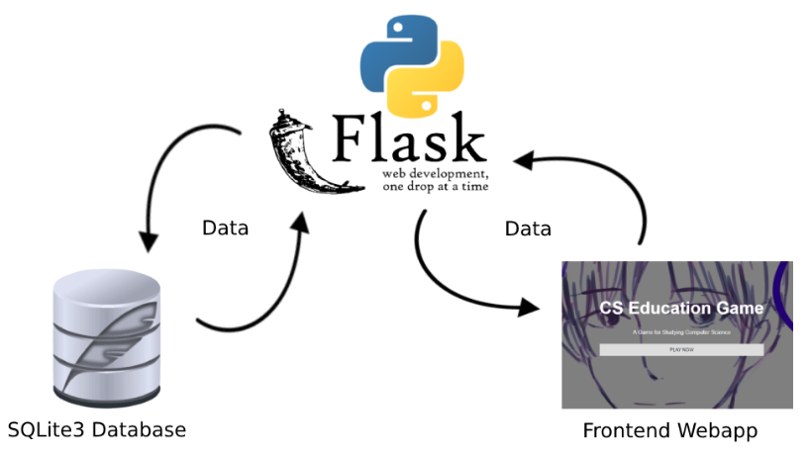
Data Flow Diagram
6

Slide 7
Technical Description
7
Development Stack
Backend
Python, Flask, SQLite3
Frontend
HTML, CSS, JavaScript
Platforms/Tools
Spyder (Python IDE)
Visual Studio Code
Tiled

Slide 8
Features
8
Authentication
Open-world Environment with Several Locations
Player Movement through Environment
NPC Interactions with Dialogue
Visual Novel Interface for Question Functionality
Puzzle Library, Playability, Creation
Question Creation

Slide 9
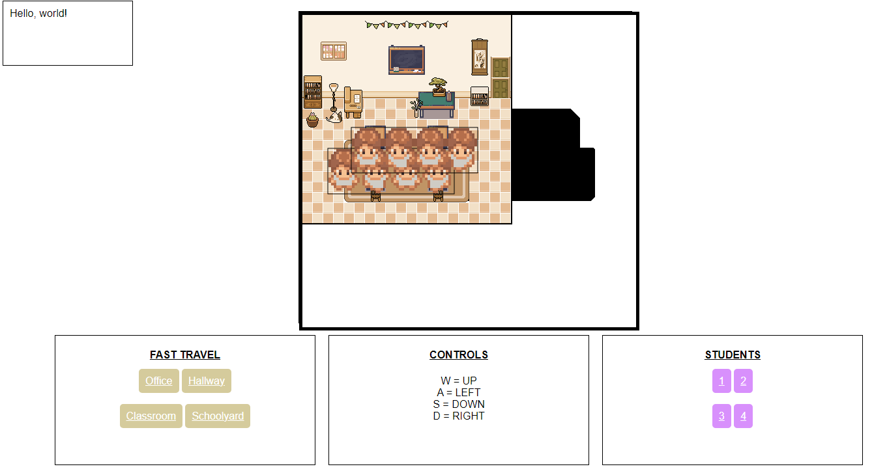
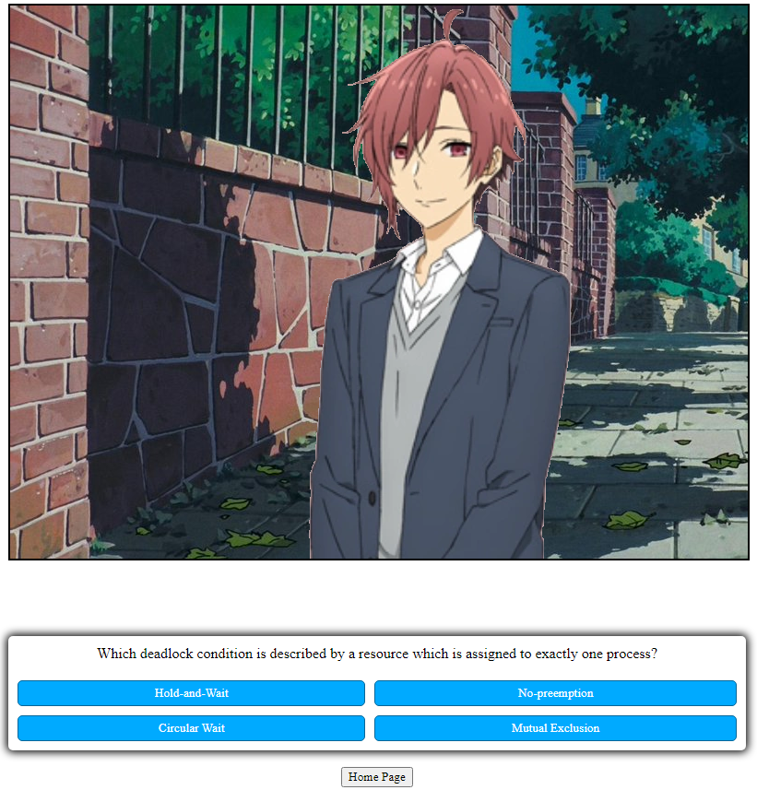
Overview
9

Slide 10
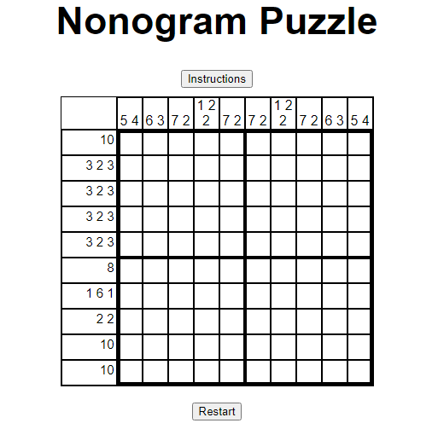
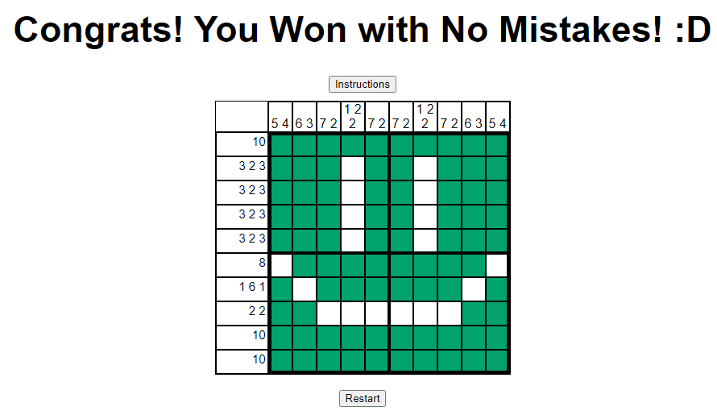
Overview
10

Slide 11
Lessons Learned
11
Plan prior to Coding
Canvas fueled mid-development swap from Python, Flask, SQLite3 to MERN and then back again
Comments are Key
Without comments, it is difficult to understand someone else’s code
Backup Work Regularly
Minimizes code loss when working
Upload to GitHub or make local copies

Slide 12
Future Work
12
Uploading Questions to the Database by CSV file
Map Traversal using doors and Map Collisions within Canvas
Changing Sprite Image based on Directional Movement

Slide 13
DEMO
13
Demonstration of Computer Science Education Game

Slide 14
Thank You!
14

